Slide 1
Vitagroup’s shift to openEHR-centric mappings
Transitioning from input-driven to storage-driven mappings

Slide 2

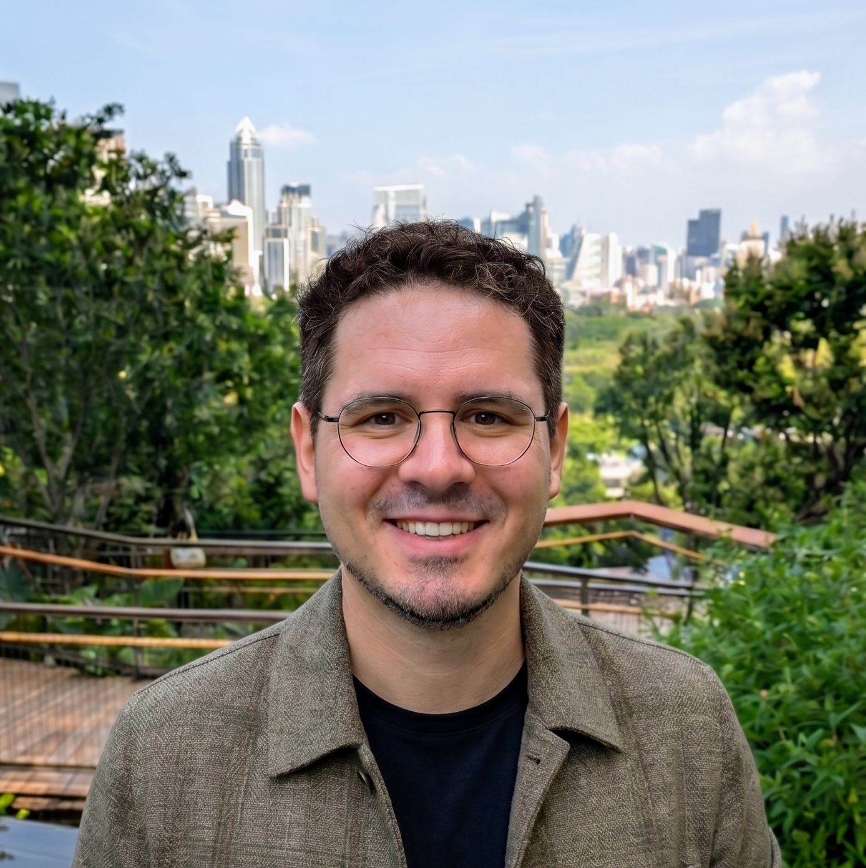
Introduction
Jake Smolka
Florian Schramm
Senior Developer
jake.smolka@vitagroup.ag
hip.vitagroup.ag
Lead Developer
florian.schramm@vitagroup.ag
hip.vitagroup.ag

Slide 3
Introduction
HIP data integration
FHIR
connector
HIP Bridge
openEHR store
(EHRbase)
HL7v2 inbound
connector
FHIR store
HL7v2 outbound
connector
Binary store

Slide 4
Introduction
FHIR connector capabilities
Single resource and bundle handling
Same feature set accross both stores
Capability Statement
Get
Search, _include, _revinclude
Create
Update, conditional Updates
Delete, $expunge
Patient $merge
_format, _pretty
…
HIP data integration
FHIR
connector
HIP Bridge
openEHR
(EHRbase)
HL7v2 inbound
connector
FHIR store
HL7v2 outbound
connector
Binary store

Slide 5
Introduction
HIP data integration
FHIR
connector
HIP Bridge
openEHR
(EHRbase)
HL7v2 inbound connector capabilities
Complete message or segment based handling
  incl custom segments
Same feature set accross both stores
Create resources
Update resources
Merge Patient
HL7v2 inbound
connector
FHIR store
HL7v2 outbound
connector
Binary store

Slide 6
Introduction
HIP data integration
FHIR
connector
HIP Bridge
openEHR
(EHRbase)
HL7v2 inbound
connector
FHIR store
HL7v2 outbound connector capabilities
Build a HL7v2 ORU_R01, MDM_T01 or MDM_T02 message out of data from both stores.
Trigger
  EHRbase trigger event
  FHIR subscription hook
HL7v2 outbound
connector
Binary store

Slide 7
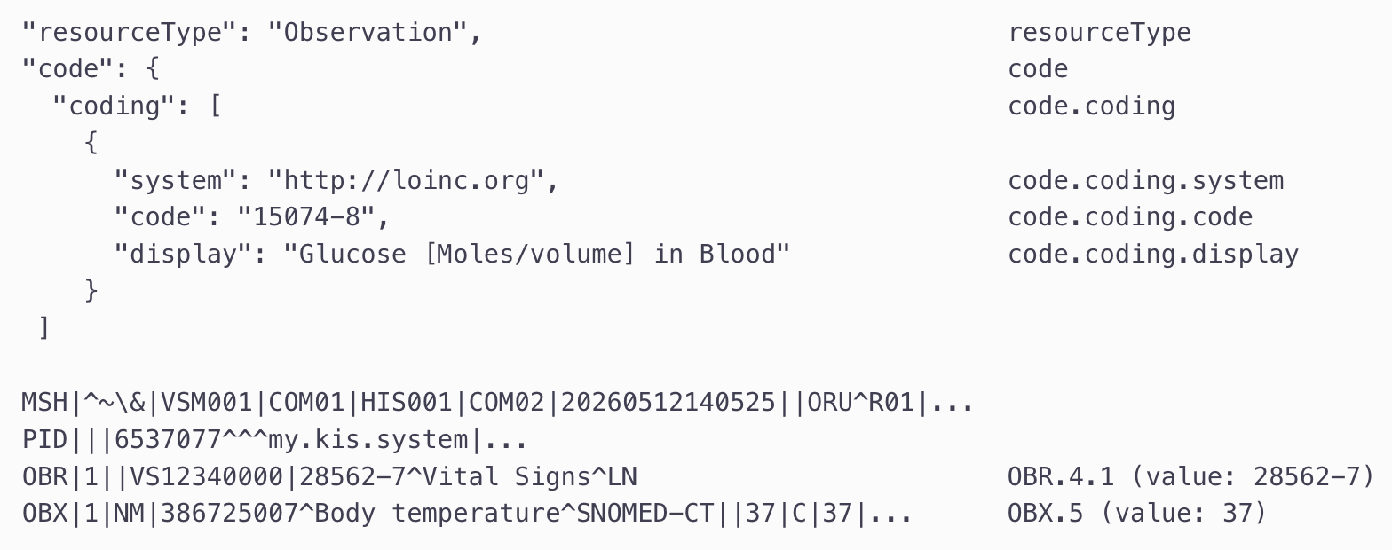
HIP Bridge configuration
Protocol Specific Path Language (PSPL)
Semantic path navigation
  Familiar path-based syntax
  Build for bidirectional path selection
  Advanced logic and hooks
Single and cross protocol support
  FHIR / HL7v2 -> openEHR
  FHIR / HL7v2 -> openEHR -> FHIR / HL7v2
  HL7v2 -> FHIR
Notes:
Mention alternatives and why we went the PSPL way

Slide 8
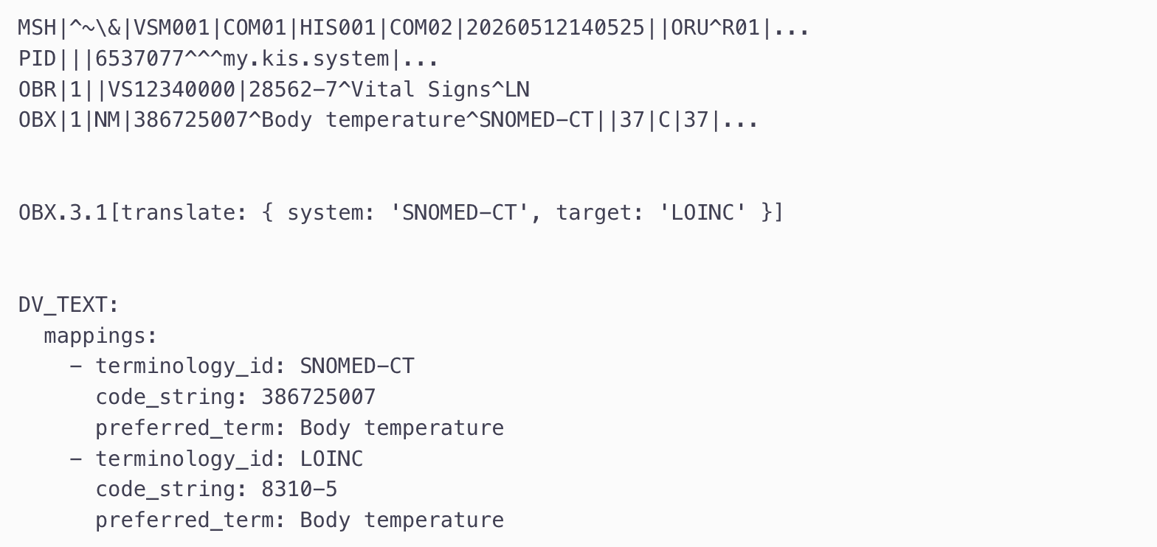
PSPL examples
Terminology translations

Slide 9
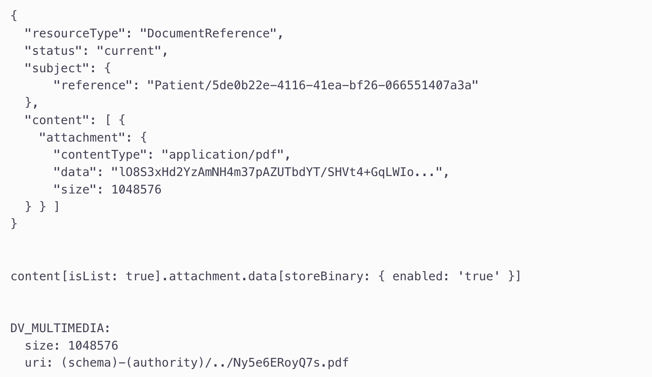
PSPL examples
Binary handling

Slide 10
From input-driven to storage-driven mappings
Input driven mappings
Mapping definitions are driven by the source resource.
Focus on parsing, routing and extracting data.
Storage driven mappings
Mapping definitions are primary
driven by openEHR archetypes.
Improving the persisting into longitudinal clinical repositories by keeping
all existing functionality.

Slide 11
Foundation: Import mappings
Encapsulation of reusable mapping definitions
Mappings:
Template Cardio
Top-level
FHIR Resource
Observation 1
openEHR Composition
(Template Cardio)
ENTRY for
Archetype BP
Highly specified cardiology report
Archetype Blood Pressure
Import
FHIR Resource
Observation 2
openEHR Composition
(Template GP)
ENTRY for
Archetype BP
Template GP
Top-level
General GP lab report

Slide 12
ID management
Basic 1:1 ID management between non-nested artifacts
FHIR Resource
ID: {uuid}
openEHR Composition
CONTENT
ENTRY (e.g., OBSERVATION)
Locatable ID:
{uuid}::{part}::{version}
`uuid` - ID of the Resource
`part` - allows splitting into multiple parts
`version` - version of the Resource

Slide 13
ID management
Advanced ID management between artifacts
FHIR Resource A
ID: {uuid-A}
openEHR Composition
ENTRY Locatable ID:
{uuid-A}::1::1
ENTRY Locatable ID:
{uuid-B}::1::1
openEHR Composition
ENTRY Locatable ID:
{uuid-A}::1::1
ENTRY Locatable ID:
{uuid-A}::2::1
FHIR Resource A
ID: {uuid-A}
FHIR Resource B
ID: {uuid-B}

Slide 14
Data creation workflow
Example: Laboratory reports, with n:n artifacts
Input: HL7v2 message with multiple OBR & OBX pairs
Mapping engine detects groups and can map data points
Template: DiagnosticReport.v1.1.1
Creating one openEHR ENTRY per segment group – applying the available plain mapping transformations
  ENTRY 1: Locatable.ID = {uuid1}::{part}::{version}
    Archetype mapping “Specimen” – path as per TOP LEVEL mapping
  ENTRY 2: Locatable.ID = {uuid2}::{part}::{version}
    Archetype mapping “Laboratory analyte result” – path as per TOP LEVEL mapping
Compose common openEHR Composition
Commit to EHRbase

Slide 15
Mapping language example
Illustration of the:
Top level mapping Import mapping
{
"name": "HL7v2 OBX to openEHR Archetypes for DiagnosticReport",
"description": "...",
"definition": {
"templateId": "DiagnosticReport.v1.1.1",
"sourceProtocol": "HL7v2",
”sourceProtocolVersions": ["2.3", "2.5", "2.5.1", "2.6"],
"sourceType": "OBX",
"storageProtocol": "openEHR",
"storageProtocolVersion": "1.1.0",
"storageType": "Composition",
"transformations": [
{
"type": "import",
"order": 1, // optional
"uri": "ag.vitagroup.mapping.hl7v2-obx-to-specimen.v1",
"basePath": "/aql/content/..." // optional
}, {
// more import blocks: archetype2, …
}
]
}
}
{
"name": "HL7v2 OBX to specific openEHR Archetype",
"description": "...",
"id": "ag.vitagroup.mapping.hl7v2-obx-to-specimen.v1",
"definition": {
"archetypeId": "openEHR-EHR-CLUSTER.specimen.v1",
"transformations": [
{
...
}
]
}
}
Notes:
Just to quickly show what this principle looks like in mappings

Slide 16
Version handling
Updating existing Composition parts
Overhauled upsert mechanism in EHRbase
  “complete_override” allows classic update
  “patch” allows patching of changed sub-structures only
FHIR Resource A
ID: {uuid-A}
openEHR Composition
Version 1
ENTRY Locatable ID:
{uuid-A}::1::1
openEHR Composition
Version 2
ENTRY Locatable ID:
{uuid-A}::1::1
ENTRY Locatable ID:
{uuid-B}::1::1
FHIR Resource B
ID: {uuid-B}

Slide 17
FHIR Resource.Meta handling
LOCATABLE.FEEDER_AUDIT
  Attached to logical Resource per Archetype, not Composition
Meta fields
  Close as possible to openEHR spec:
    Meta.lastUpdated -> feeder_audit/originating_system_audit/time
  Or logical:
    Meta.version -> from ID pattern in Locatable ID
  Otherwise:
    feeder_audit or other_details

Slide 18
Streamlined FHIR search via AQL
GET Observation?code=718-7&_lastUpdated=ge2025-02-01&_sort=_lastUpdated&_limit=100
SELECT
e/ehr_id/value,
c0/uid/value,
o/uid/value as fhir_id ,
o/feeder_audit/originating_system_audit/time/value
FROM EHR e
CONTAINS COMPOSITION c0
CONTAINS OBSERVATION o[openEHR-EHR-OBSERVATION.labresult.v2] ← for each Archetype-based mapping
WHERE
o/data[at0001]/events[at0006]/data[at0003]/items[atXXXX]/value/defining_code/code_string='718-7'
AND
o/feeder_audit/originating_system_audit/time >= ‘2025-02-01T…'
ORDER BY o/feeder_audit/originating_system_audit/time ASC
Notes:
Evaluate possible Archetypes by searching for existing mappings with matching metadata (e.g. FHIR type Observation)
Create query for each possible Archetype
Send all to EHRbase in one custom query message
Post processing in EHRbase

Slide 19
Roundtrip overview
Creating openEHR Compositions by HL7v2 message and search via FHIR
Allows round-trip:
POST HL7v2 -> openEHR
SEARCH openEHR -> FHIR
HL7v2 Message
Segment (group) A
Segment (group) B
openEHR Composition
ENTRY Locatable ID:
{uuid-A}::1::1
ENTRY Locatable ID:
{uuid-B}::1::1
FHIR Resource A
ID: {uuid-A}
FHIR Resource B
ID: {uuid-B}
Notes:
Note that we already support v2 <---> FHIR

Slide 20
Outlook
Enhanced FHIR integration
  FHIR profiling on existing data
    Either allows parallel processing of generic AND profiled data
    Or even allows to read data from profile A as profile B representation
  Moving closer to the FHIR specs
    Aligned FHIR REST API
    Support complex FHIR search operations
General custom mapping language enhancements
  Specialization of arbitrary mapping definitions
  Quicker mapping project ramp-up
Community alignment
  Importer for existing mapping specs
Notes:
FHIR REST API: _history, READ operation, HTTP header

Slide 21
Vitagroup’s shift to openEHR-centric mappings
Transitioning from input-driven to storage-driven mappings
Jake Smolka
Florian Schramm
Senior Developer
jake.smolka@vitagroup.ag
hip.vitagroup.ag
Lead Developer
florian.schramm@vitagroup.ag
hip.vitagroup.ag
vitagroup AG
Gottlieb-Daimler-Straße 8
68165 Mannheim
Tel +49 (0) 621 121 849-0
Email info@vitagroup.ag
Web www.vitagroup.ag
Notes:
Thanks for your time. And we are looking forward for your feedback and questions.

