Slide 1
On track of COVID-19
An openEHR based application to follow up patients regarding COVID-19

Slide 2
Overview
Patientlist for a ward. 3 columns with values from the tracking.
Screening: Done
Status: Suspected / Confirmed
Or reasons for "negative screening"
Tracking: Not started/Started/Finished

Slide 3
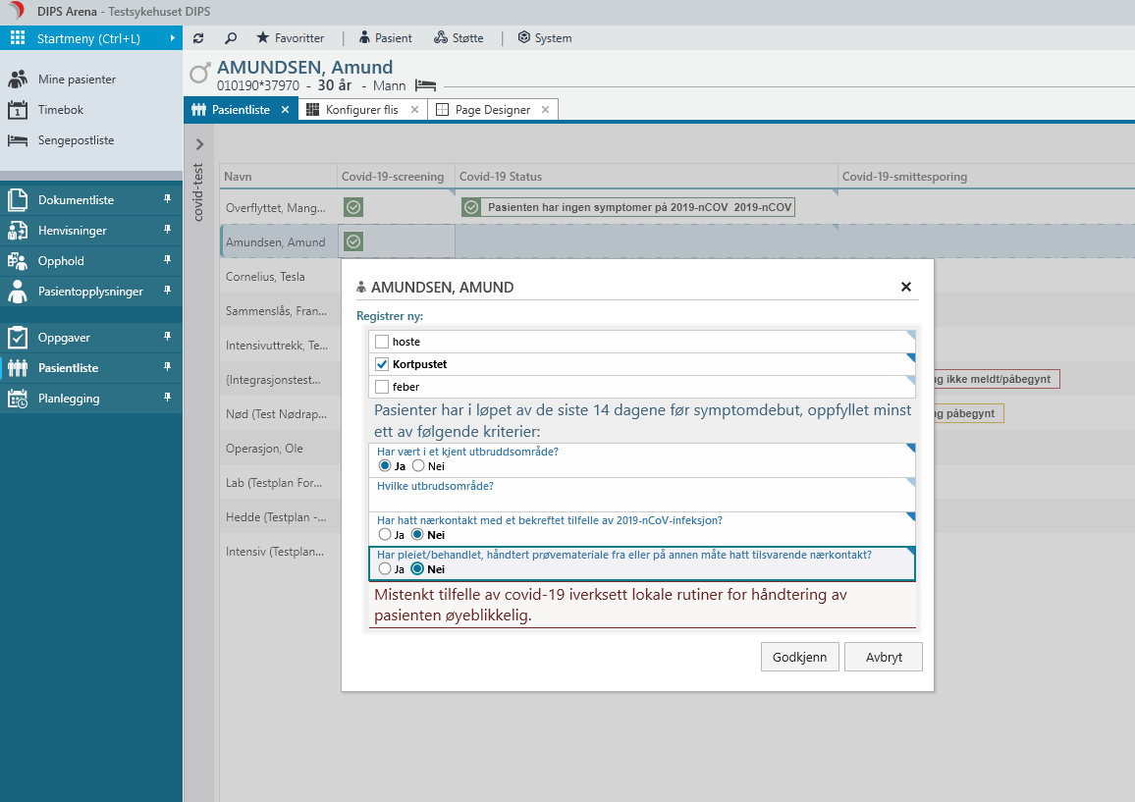
Form for screening
Based on the definition from the Public Health Institute for «Suspected patients»
Risk patients:
One symptom and one or more risk factors.

Slide 4
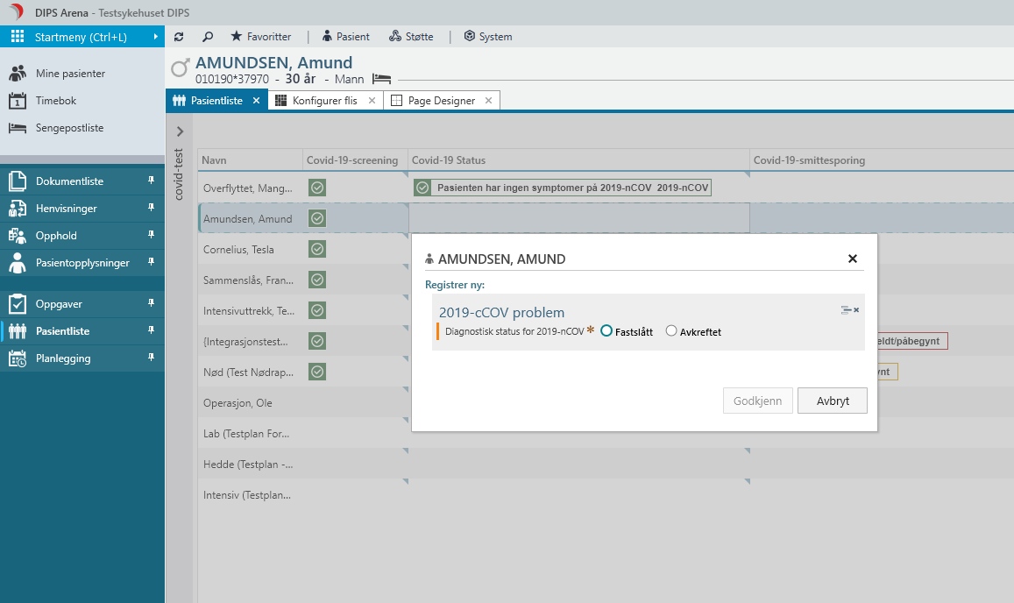
Form to follow up the diagnostic process
Possibility to record the infection state: Confirmed or disproved

Slide 5
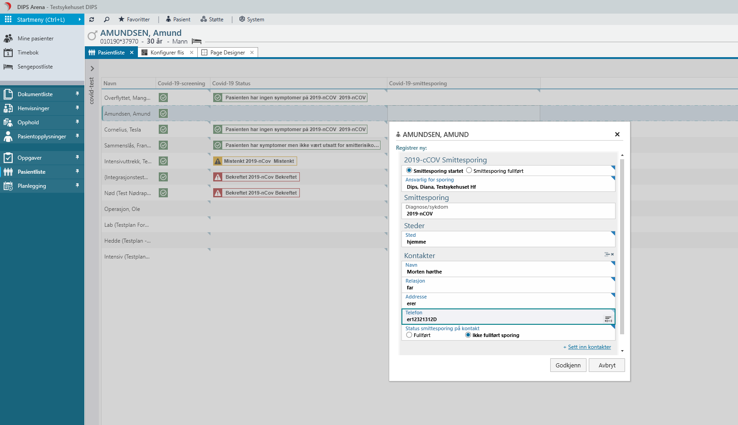
Form for contact tracking
Overall state on contact tracking
Who is responsible for the trackin.
Locations where the infected patiens have been with the possibility to add contact info for each location.

